Slide 1
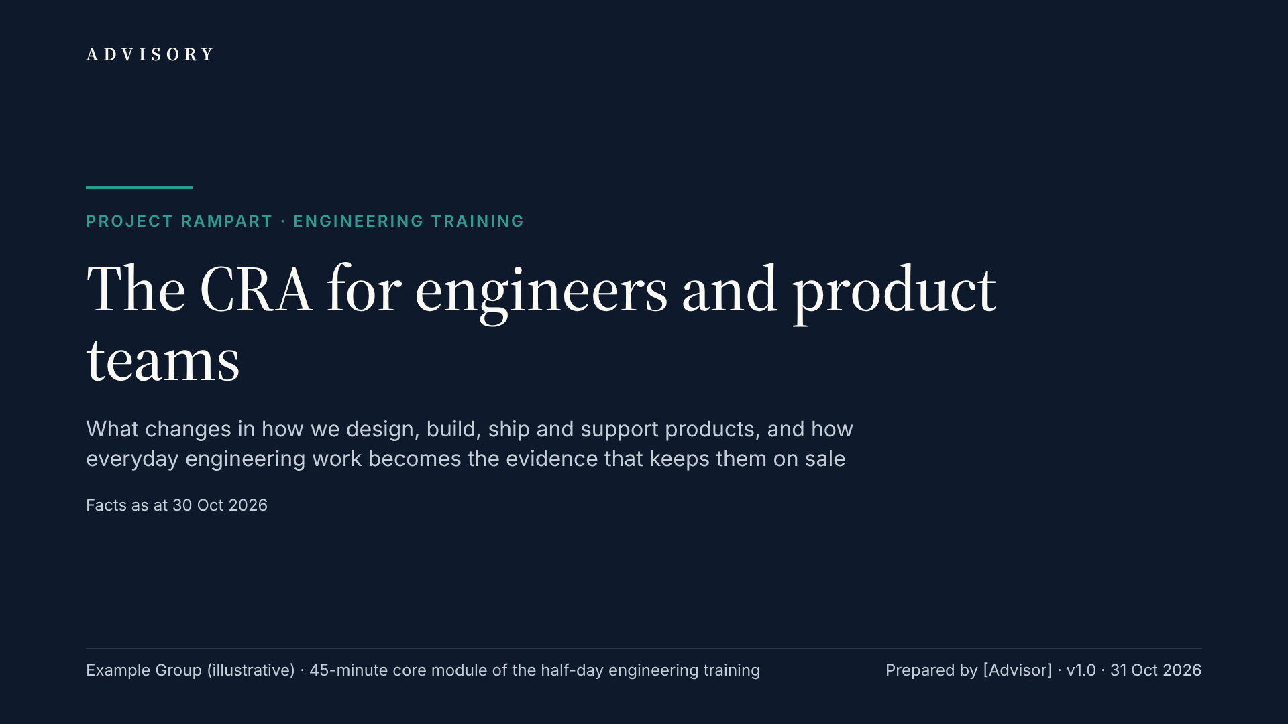
Notes:
Welcome. This is the 45-minute core module of the half-day engineering training in Project Rampart, Example Group’s programme to be ready for the EU Cyber Resilience Act by 11 Dec 2027. It is written for engineers, tech leads, product managers, release managers and PSIRT staff, and it is practical: what changes in how we design, build, ship and support our products. We follow the lifecycle — design, build and release, ship and support, evidence — and use the T200 Smart Thermostat as the running example. A five-question knowledge check comes near the end, so keep notes. Facts are as at 30 Oct 2026; where guidance or standards are still drafts, the slide says so, and all Example Group figures are illustrative. Hold detailed questions for the end or post them in the programme channel. Our target is 60% of our 920 engineers trained by Mar 2027.

Slide 2
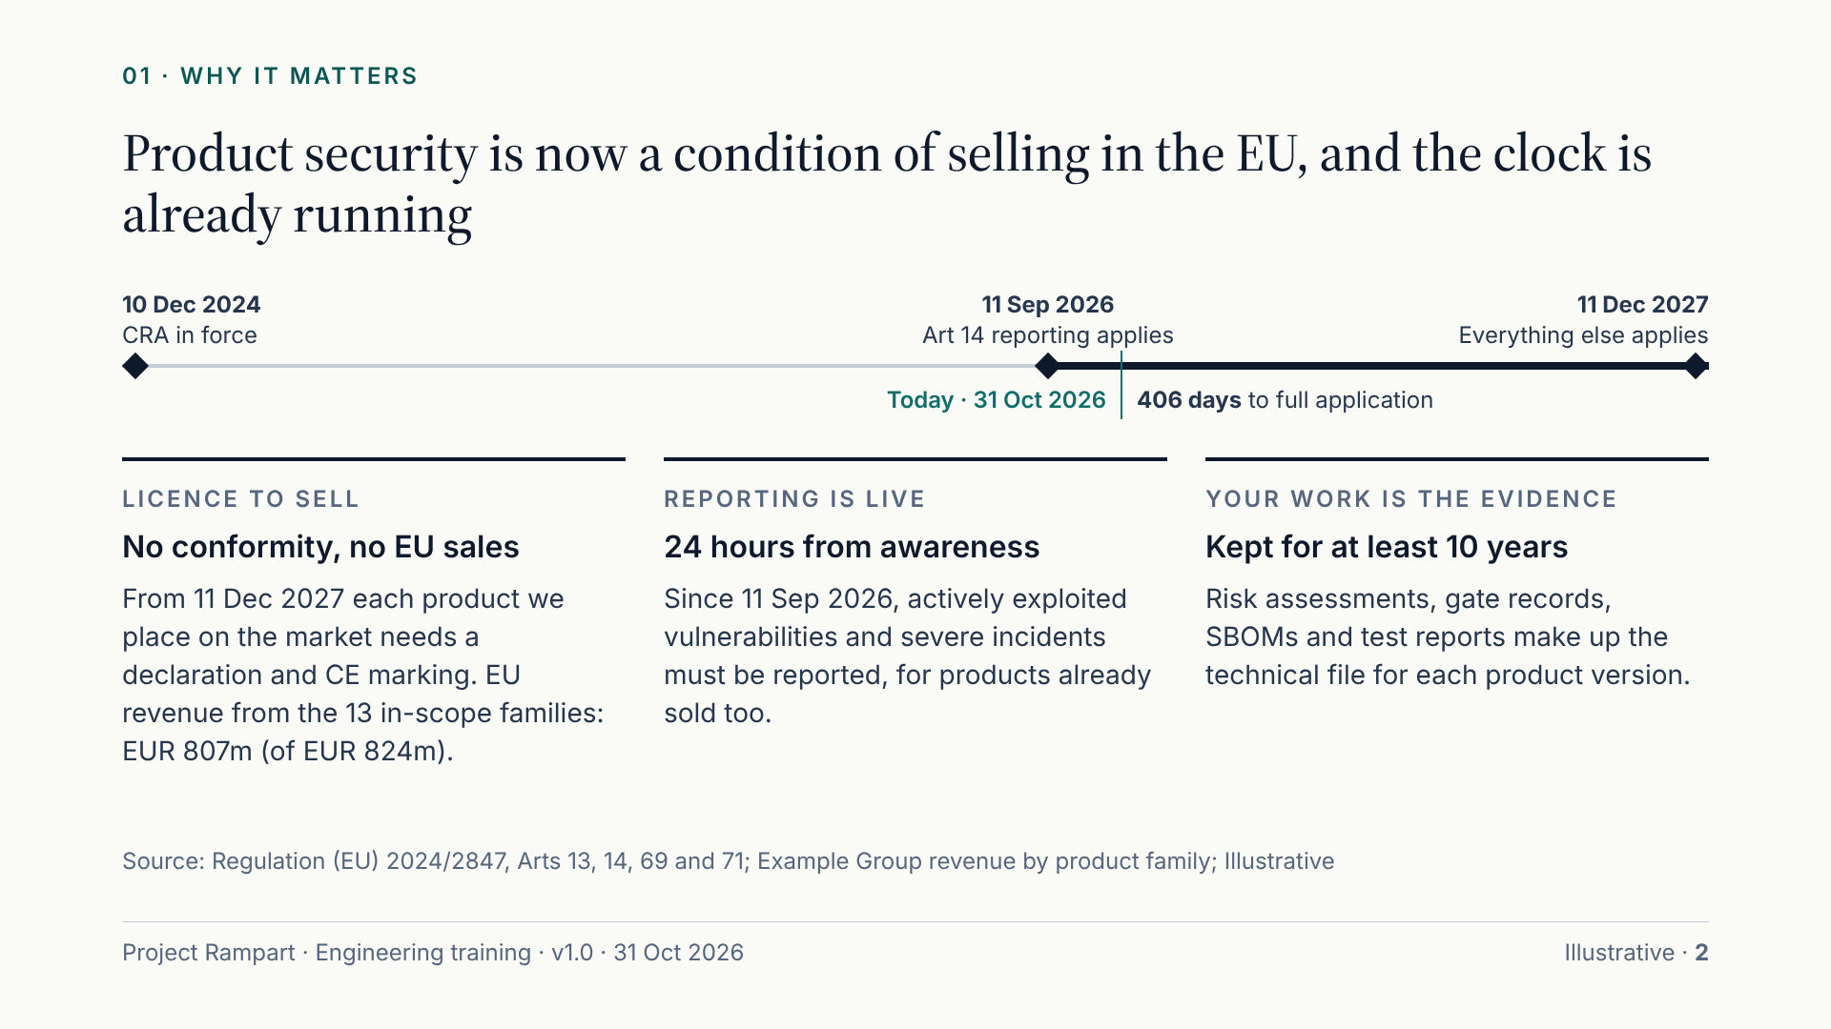
Notes:
Start with why. The Cyber Resilience Act, Regulation (EU) 2024/2847, has been in force since 10 Dec 2024. One part is already live: since 11 Sep 2026, Article 14 requires us to report actively exploited vulnerabilities and severe incidents, starting with an early warning within 24 hours of becoming aware. It covers every in-scope product, even those sold years ago. Everything else applies from 11 Dec 2027, 406 days from 31 Oct 2026. From then, a product can only be placed on the EU market with a declaration of conformity and CE marking showing that the essential requirements are met. In the illustrative figures, EU revenue from our 13 in-scope families is EUR 807m of EUR 824m. The point for this room: proof comes from your daily work. Risk assessments, gate records, SBOMs and test reports become the technical file. Maximum fines reach EUR 15m or 2.5% of worldwide annual turnover, whichever is higher.

Slide 3
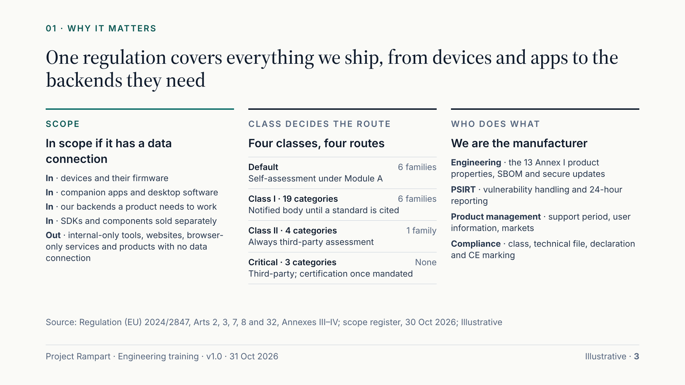
Notes:
The CRA in sixty seconds. Scope is broad: any product with digital elements sold in the EU whose intended or foreseeable use includes a data connection, direct or indirect. That covers our devices and firmware, our companion apps, software products such as ConfigStudio, our SDK, and our own backends where a product needs them. Internal-only tools, websites and browser-only services are out. The class decides the route to market. Default products self-assess under Module A. Class I products, such as our routers, switches, smart lock and video doorbell, need a notified body unless a harmonised standard is cited and applied in full; none is cited as at 30 Oct 2026. Class II, our SG-900 firewall, always needs third-party assessment. As manufacturer we carry almost every obligation: engineering builds the Annex I properties, PSIRT runs vulnerability handling and reporting, product management sets support periods, and compliance owns the technical file.

Slide 4
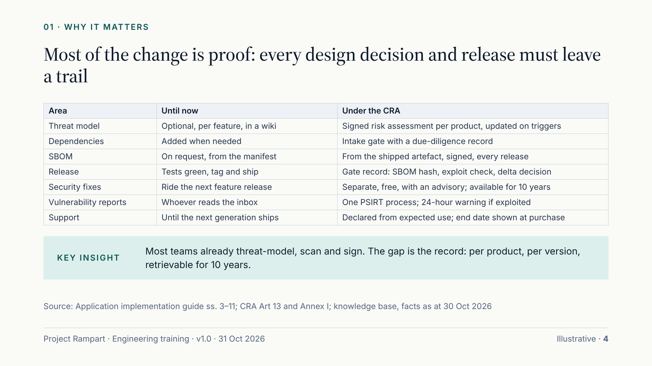
Notes:
If you remember one slide, make it this one. Most of what changes is not new security engineering; many teams already threat-model, scan and sign. What changes is that every decision must leave a trail that an authority or notified body can follow, per product and per version, for at least ten years. Walk the rows. Threat models become a signed risk assessment per product. Dependencies pass an intake gate. The SBOM is generated from what we ship and signed. Releases pass a security gate that produces a record. Security fixes ship separately, free and with an advisory. Vulnerability reports go to PSIRT, and active exploitation starts a 24-hour clock. Support periods are declared from expected use and shown at purchase. Ask the room which row is furthest from how their team works today, and note the answers for the programme team.

Slide 5
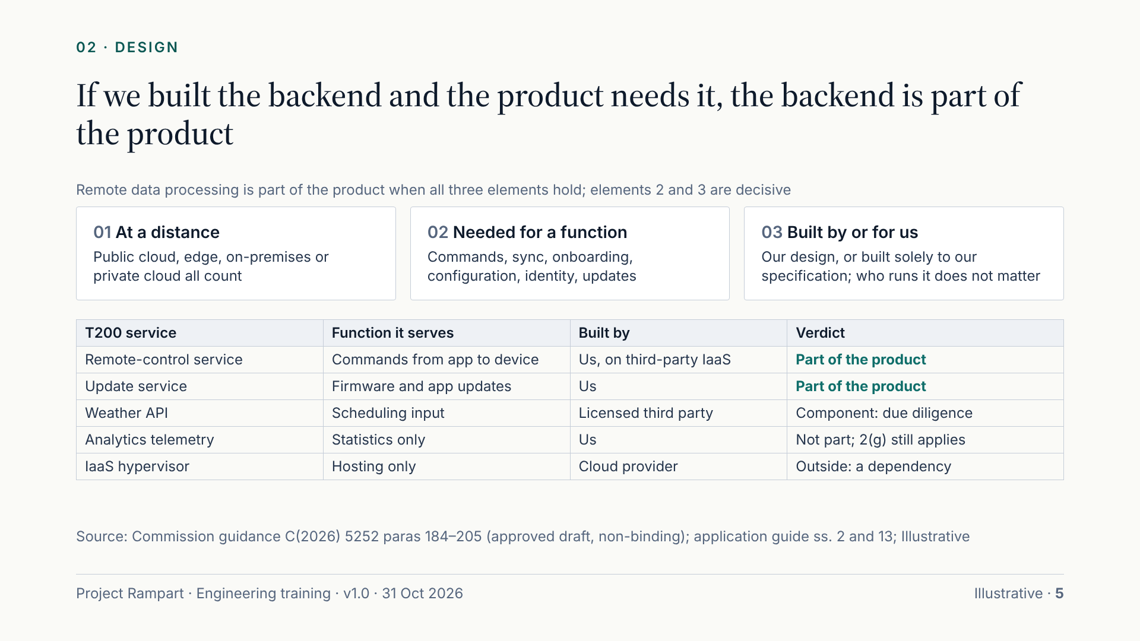
Notes:
First design question: where does our product end? The Commission guidance gives a three-element test for remote data processing. One, the processing happens at a distance, and edge, on-premises and private cloud all count. Two, without it the product cannot perform one of its functions; functions include sending commands, sync, onboarding, configuration, identity and update distribution. Three, we designed and developed it, or had it built solely to our specification. Elements two and three are decisive and cumulative; who operates it does not matter. Apply it to the T200. Our remote-control and update services are part of the product even though they run on third-party IaaS. The licensed weather API fails element three, so it is a component that needs due diligence instead. Analytics telemetry is not remote data processing, but data minimisation still applies. Record the result as a remote-function map.

Slide 6
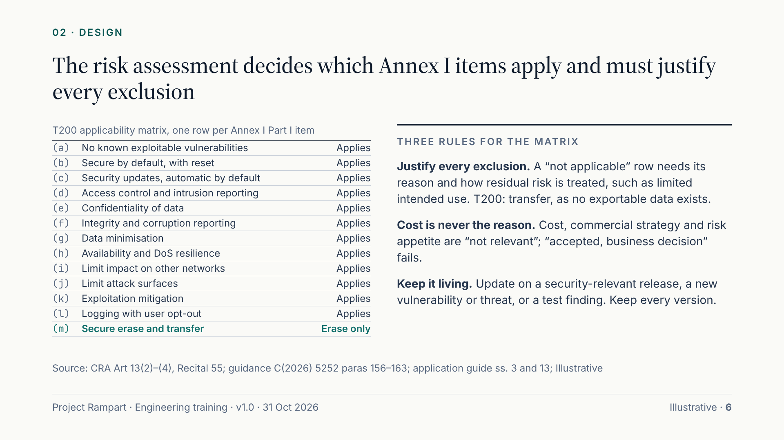
Notes:
The Article 13 risk assessment is the engine of compliance. It rests on intended purpose, foreseeable use, conditions of use and expected time in use, and it must state, item by item, whether each of the thirteen Annex I Part I requirements applies and how it is implemented. No method is mandated; what matters is a trail from asset to threat to decision to evidence. The T200 uses the BSI TR-03183-1 structure with STRIDE on the data-flow diagram, and all items apply except the transfer half of item (m). Three rules catch teams out. Every exclusion needs a justification and a treatment of the residual risk. Cost, commercial strategy and risk appetite are not valid reasons: “accepted, business decision” fails, while “physical access required, documented in the user information” can pass. And the assessment is living: update it on triggers, including substantial-modification checks, and keep every version.

Slide 7
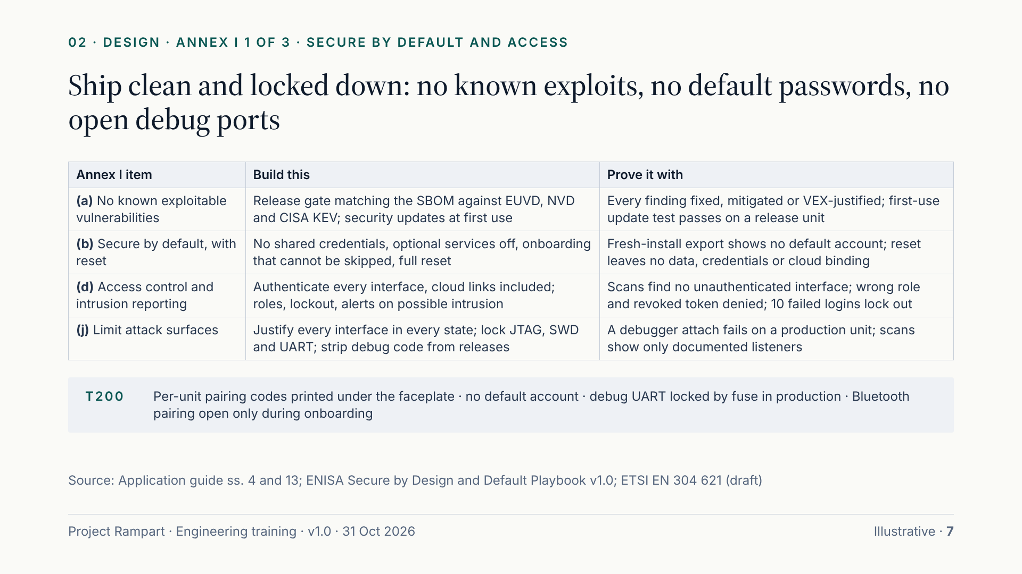
Notes:
The next three slides turn the thirteen items into patterns: what to build, and the acceptance test that proves it. Each test produces evidence for the technical file. The four items here are treated as near-universal in the draft standards, so expect to apply them. Item (a): ship without known exploitable vulnerabilities; we cover the release check in detail shortly. Item (b): no shared or default credentials, optional services off, and a reset that truly wipes data, credentials and cloud bindings. Item (d): authenticate every interface, including device-to-cloud and management paths, and surface possible unauthorised access; that reporting half is often missed. Item (j): justify every exposed interface in every product state, and lock debug ports in production. On the T200 that means per-unit pairing codes, no default account, a fused UART and Bluetooth pairing only during onboarding.

Slide 8
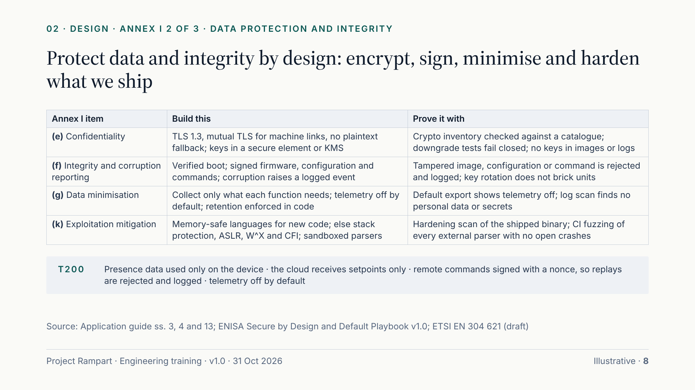
Notes:
Data protection and integrity. Item (e): TLS 1.3 or equivalent, mutual authentication on machine-to-machine links, no plaintext fallback, and data at rest encrypted with keys held in a secure element, TEE or key-management service. Keep a cryptographic inventory against a published catalogue. Item (f): verified boot from a root of trust, signed firmware and configuration, authenticated commands, and a logged or visible event when corruption is detected; silent repair is not enough. Item (g): collect only what each function needs, keep telemetry off by default with opt-in, and enforce retention in code rather than in policy. Item (k): use memory-safe languages for new code where possible; otherwise harden the build, sandbox parsers and verify the flags on the shipped binary. The T200 shows the pattern: presence data stays on the device, the cloud sees setpoints only, and signed commands with a nonce defeat replay.

Slide 9
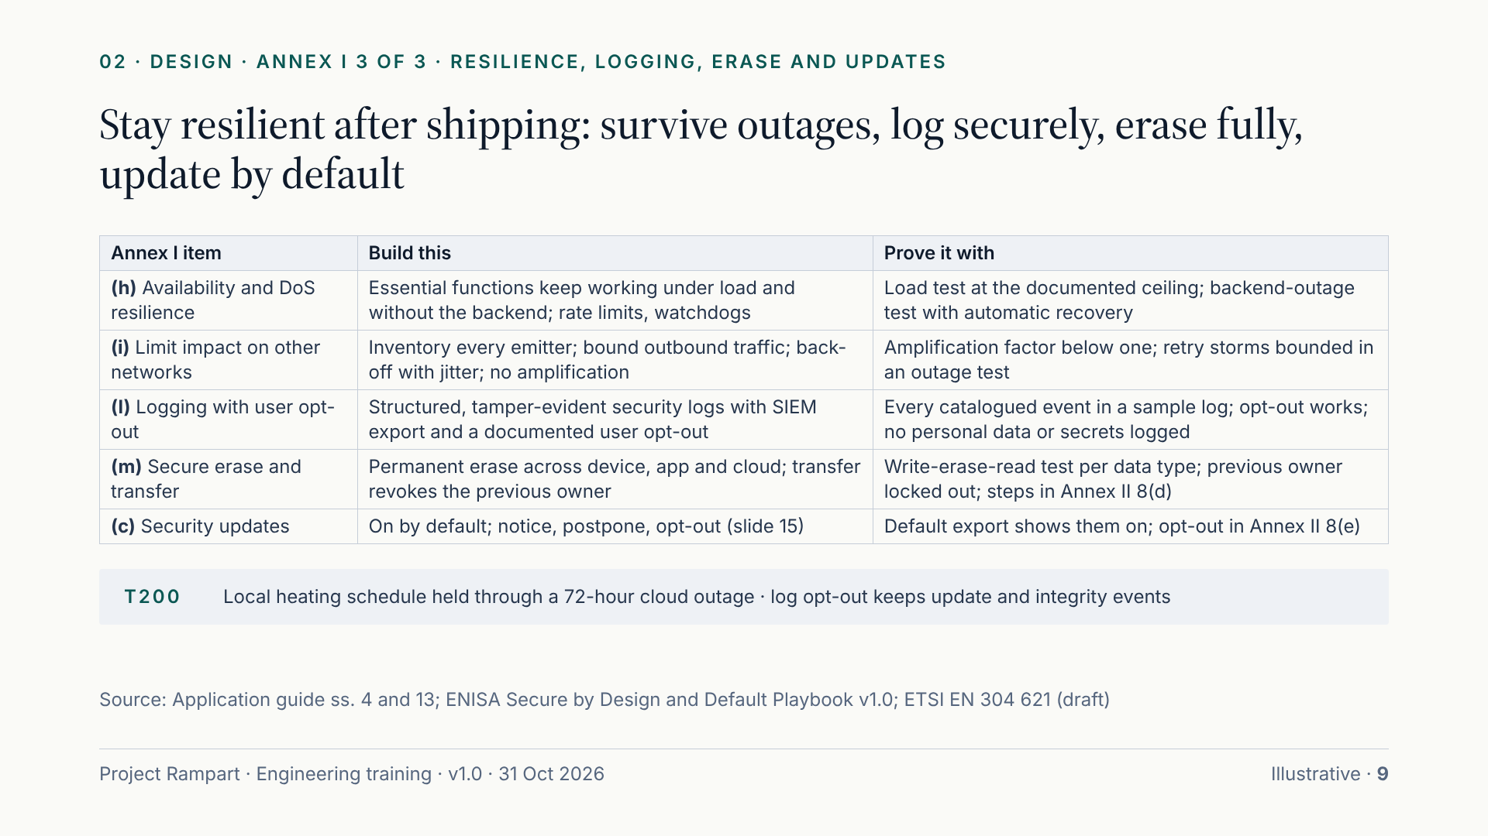
Notes:
The last group. Item (h): list the essential functions and keep them working under load and when the backend is down; the T200 kept heating on its local schedule through a 72-hour cloud outage test. Item (i): do not harm other networks. Inventory every emitter, bound retries with back-off and jitter, and never let the product act as an amplifier or relay. Item (l): log security events in structured, tamper-evident form with export to the customer’s SIEM and a user opt-out; document which security events persist after opt-out and why. Item (m): erase must be permanent across device, app and cloud, and a transfer must revoke the previous owner. Item (c), security updates, gets its own slide later. Remember that any “not applicable” needs a justification in the risk assessment: the T200 marks only the transfer half of (m), because no exportable data exists beyond schedules.

Slide 10
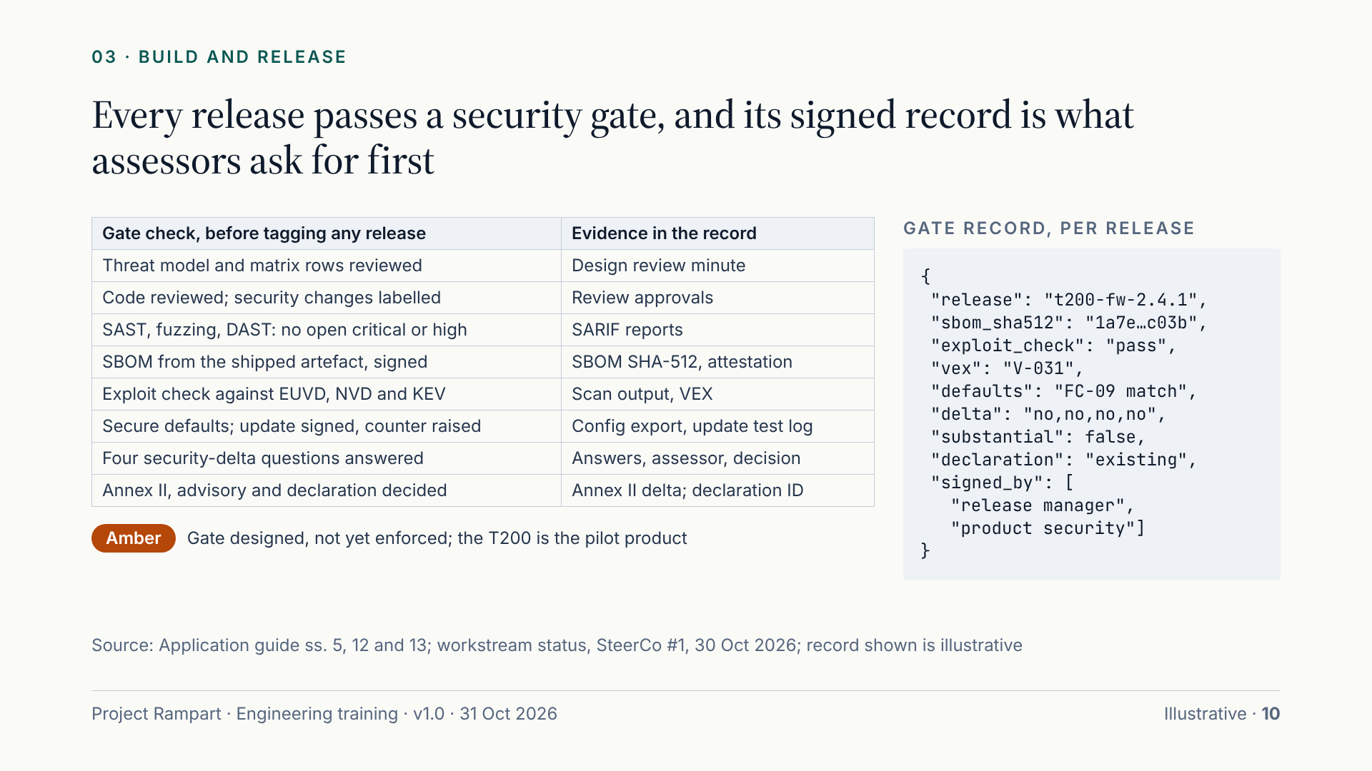
Notes:
The release security gate is where design meets evidence. It runs before tagging any release and checks four things: the build was reviewed and tested; the supply chain is clean, meaning a signed SBOM and a known-exploitable check; the shipped configuration is secure and the update is signed with its rollback counter raised; and the market decisions are made: whether this is a substantial modification, what documentation changes, and whether the existing declaration still covers it. The output is the gate record, a structured file committed with the release tag and signed by the release manager and the product security owner. The implementation guide calls it the single most useful artefact in the file, because it ties a shipped artefact to its tests, SBOM and decisions. Status: the gate is designed but not yet enforced, and the T200 is the pilot product.

Slide 11
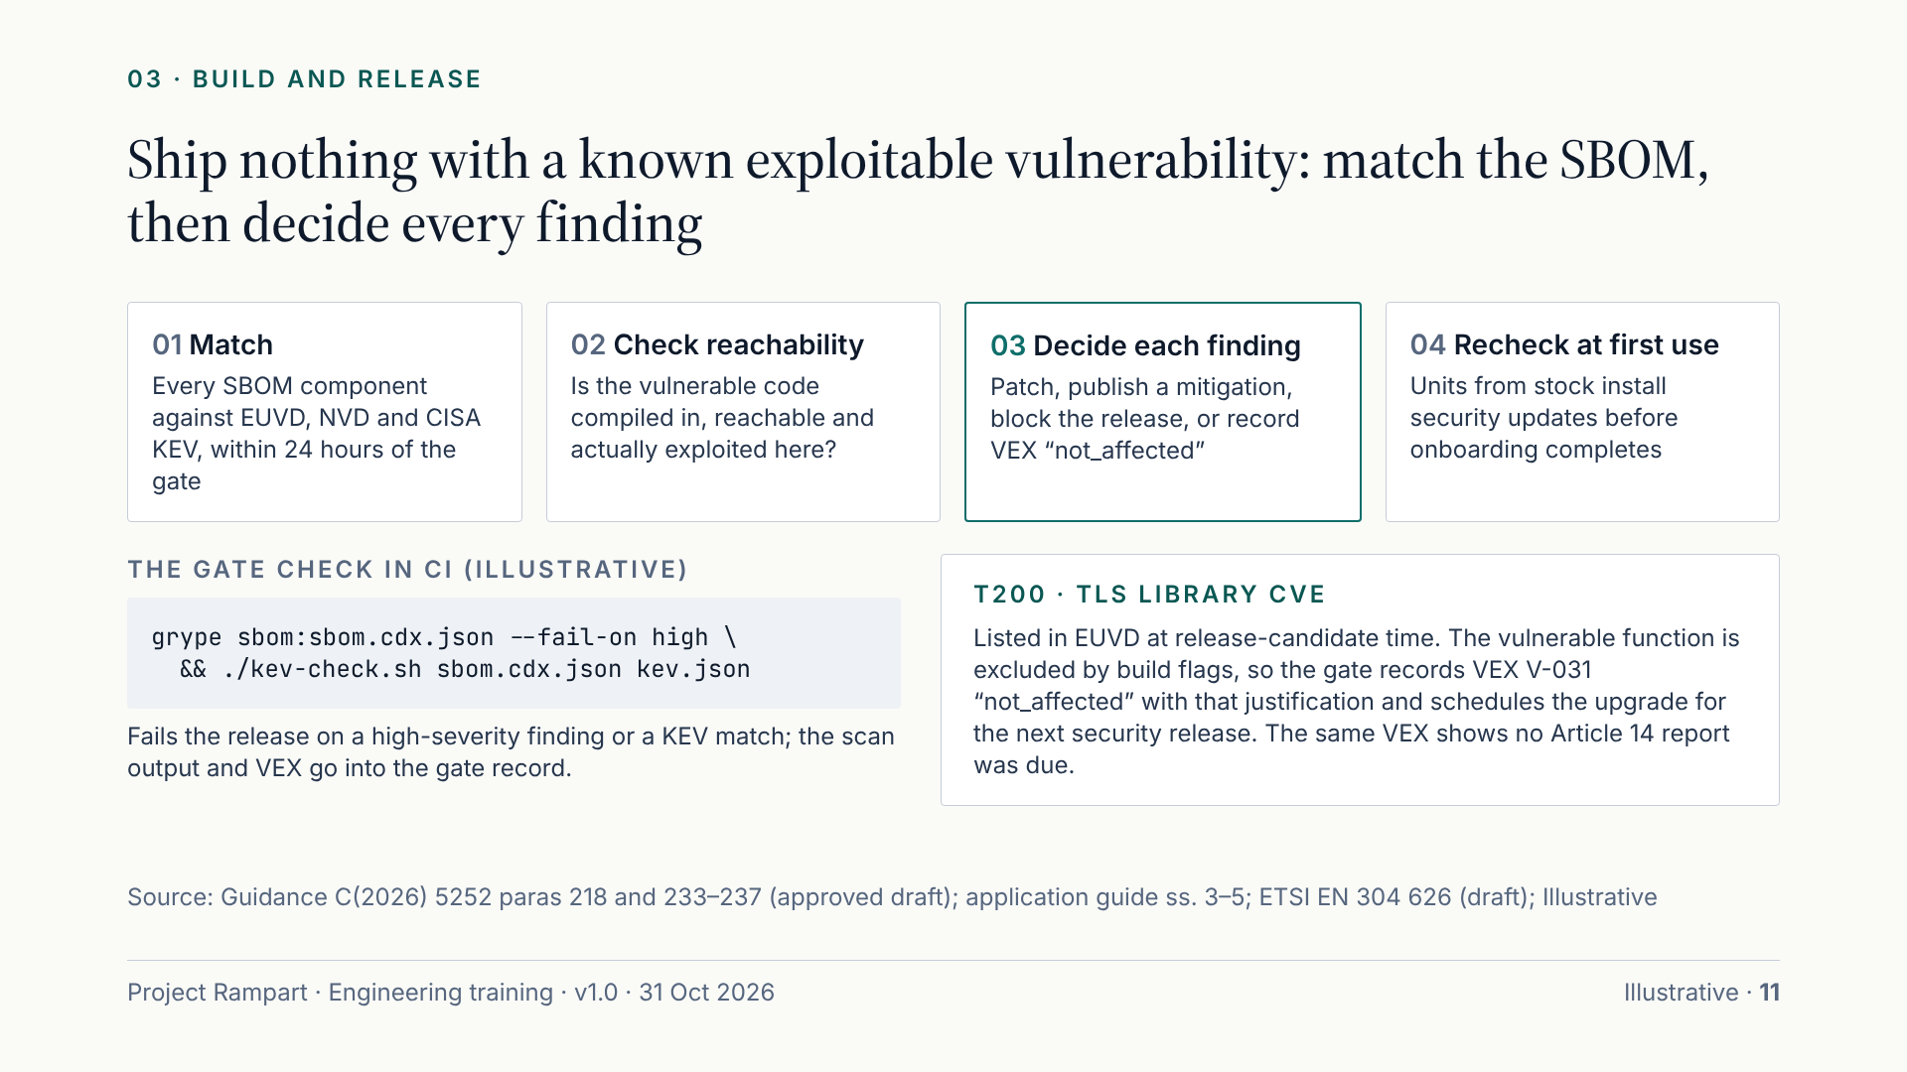
Notes:
Item (a) in practice. The Commission treats a vulnerability as “known” once it is listed in the EUVD or another prominent database, or disclosed to us privately, found in our own testing or widely reported. At every release, match each SBOM component against the EUVD, the NVD and the CISA Known Exploited Vulnerabilities catalogue, within 24 hours of the gate. Then decide each finding: apply the available patch, publish a documented mitigation, block the release, or, if our product is not affected, record a VEX “not_affected” statement with the reachability justification. Reachability comes first: a CVE whose code is not compiled in or not reachable is not exploitable in our product. The TLS example shows a complete trail, and the same VEX is the evidence that no Article 14 report was due. Finally, units that sat in a warehouse must install security updates at first boot, before onboarding completes.

Slide 12
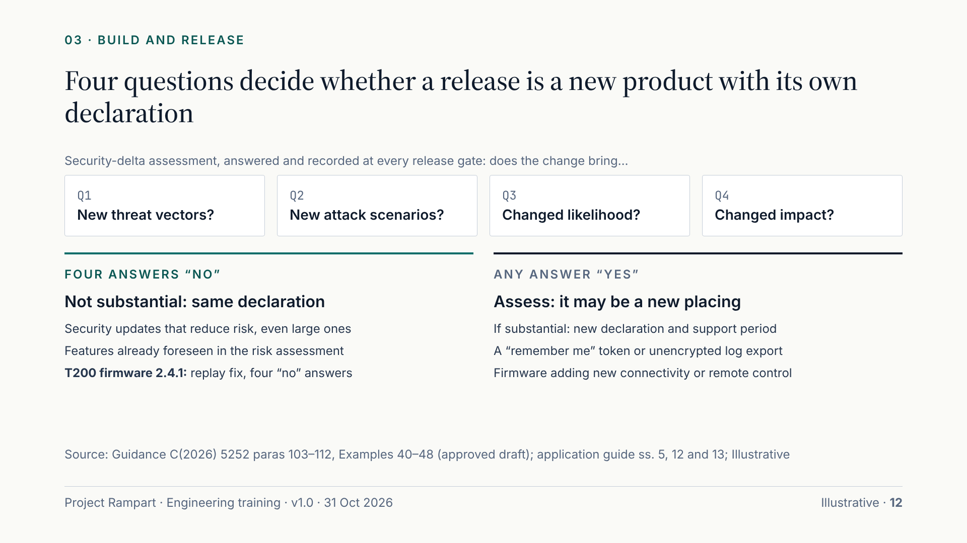
Notes:
Every release answers one question: is it a substantial modification? If it is, the release is a new placing, with its own declaration and support period, and a notified body must be informed where one is involved. The test is about risk, not size. Ask the four questions from guidance paragraph 110: does the change bring new threat vectors, new attack scenarios, a changed likelihood of a known scenario, or a changed impact? Four “no” answers, with the risk assessment still valid, mean it is not substantial. Security updates that reduce risk and keep the intended purpose are generally not substantial, even when large. Small features can be: a “remember me” token or an unencrypted log export added risk nobody assessed. The T200 firmware 2.4.1 security fix answered four “no”s and shipped under the existing declaration. Record the answers, the assessor and the decision on the gate record.

Slide 13
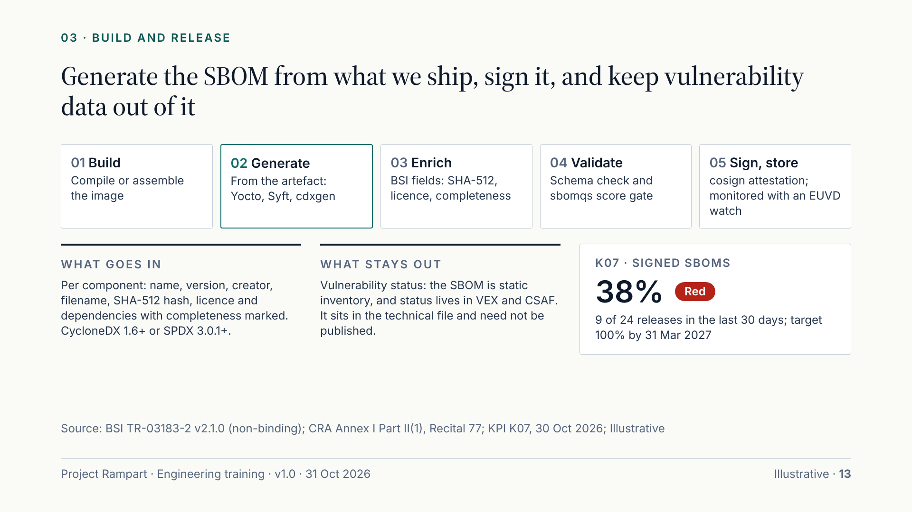
Notes:
The SBOM must come from what we ship. A manifest-only SBOM misses vendored code, statically linked libraries and binaries copied into images. Generate it straight after the build, and where the build cannot see a component, scan the final image and merge the results. Our profile is BSI TR-03183-2: CycloneDX 1.6 or SPDX 3.0.1 or later, with per-component name, version, SHA-512 hash, licence and dependencies with completeness marked. Two rules matter. No vulnerability data in the SBOM: it is a static inventory, and status lives in VEX and CSAF. And sign it, bound to the artefact digest, with its hash in the gate record. The SBOM is part of the technical file; we need not publish it. Today only 38% of releases ship a signed SBOM, against a target of all by 31 Mar 2027, and home-product firmware SBOMs are still manifest-only, so binary scanning is being added.

Slide 14
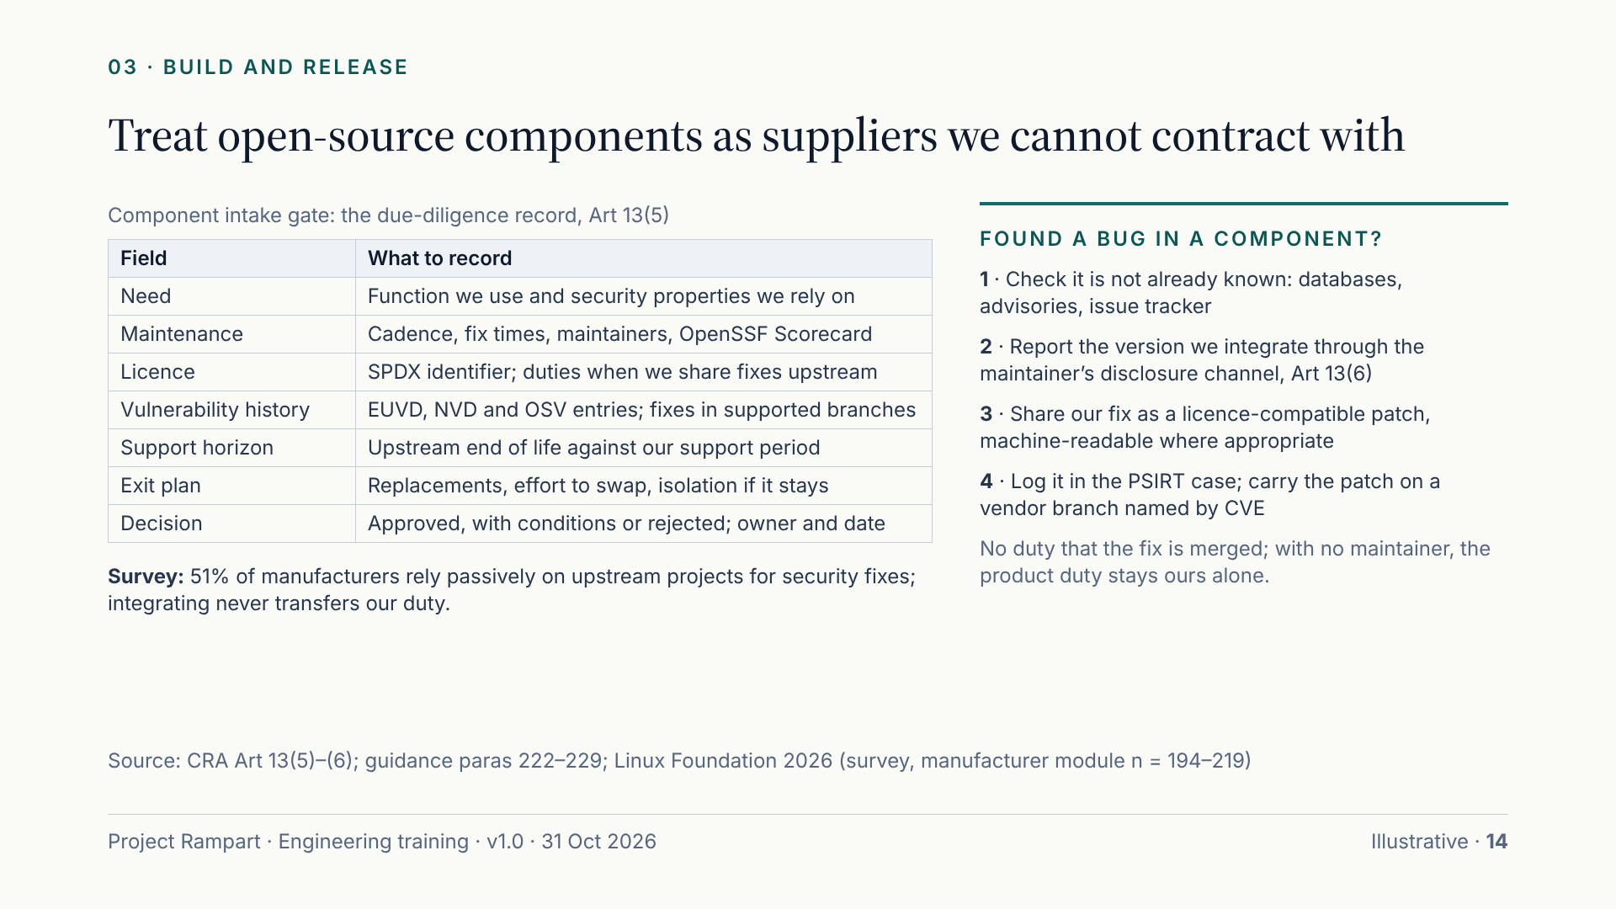
Notes:
Open source is most of what we ship, and integrating it never transfers our duty. Treat each component as a supplier you cannot contract with. Before a dependency enters the product, the intake gate records the need, maintenance signals such as release cadence and the OpenSSF Scorecard, the licence, vulnerability history, the upstream support horizon against our support period, and an exit plan. A component whose upstream support ends inside our support period needs that exit plan at intake. When we find a vulnerability in a component, Article 13(6) requires us to report it to the maintainer through their disclosure channel and to share any fix we develop. There is no duty that it is merged, and none where no maintainer exists, but then the product duty is ours alone. Keep patches as discrete commits on a vendor branch named by CVE; silent forks become our maintenance burden.

Slide 15
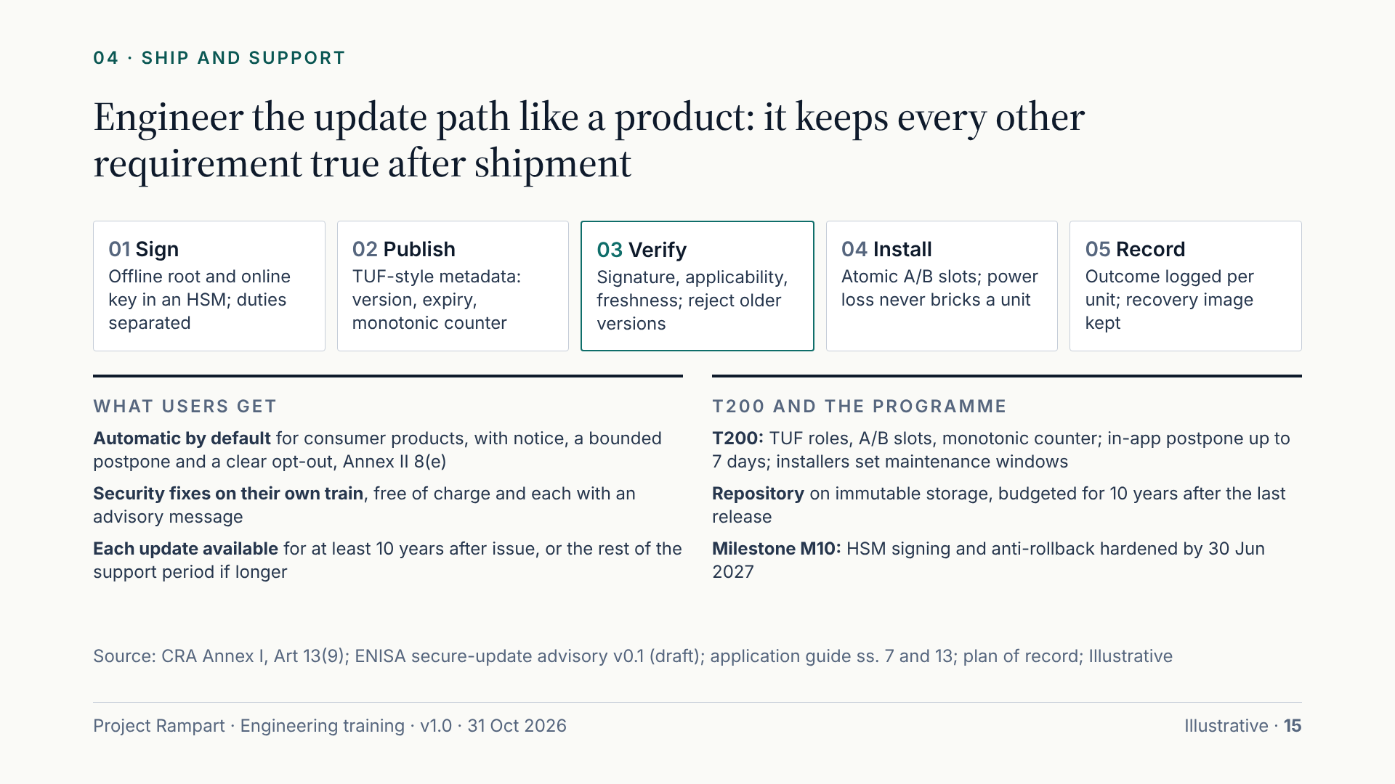
Notes:
The update mechanism keeps every other requirement true after shipment, so design it as a security product. Keys: an offline root and an online signing key, both in an HSM or cloud KMS, with build, release approval and key custody held by different people. Metadata follows TUF or Uptane, with expiry and a monotonic counter. The device verifies signature, applicability and freshness before writing anything, rejects older versions unless a downgrade is explicitly authorised and audited, and installs atomically to an A/B slot so power loss never bricks a unit. For consumer products, automatic security updates are on by default, with notification, postponement and a clear opt-out; managed estates use scheduling instead, a carve-out claimed only in the risk assessment. Security fixes ship on their own train, free, with an advisory, and each stays available for at least ten years. HSM signing and anti-rollback are due by 30 Jun 2027.

Slide 16
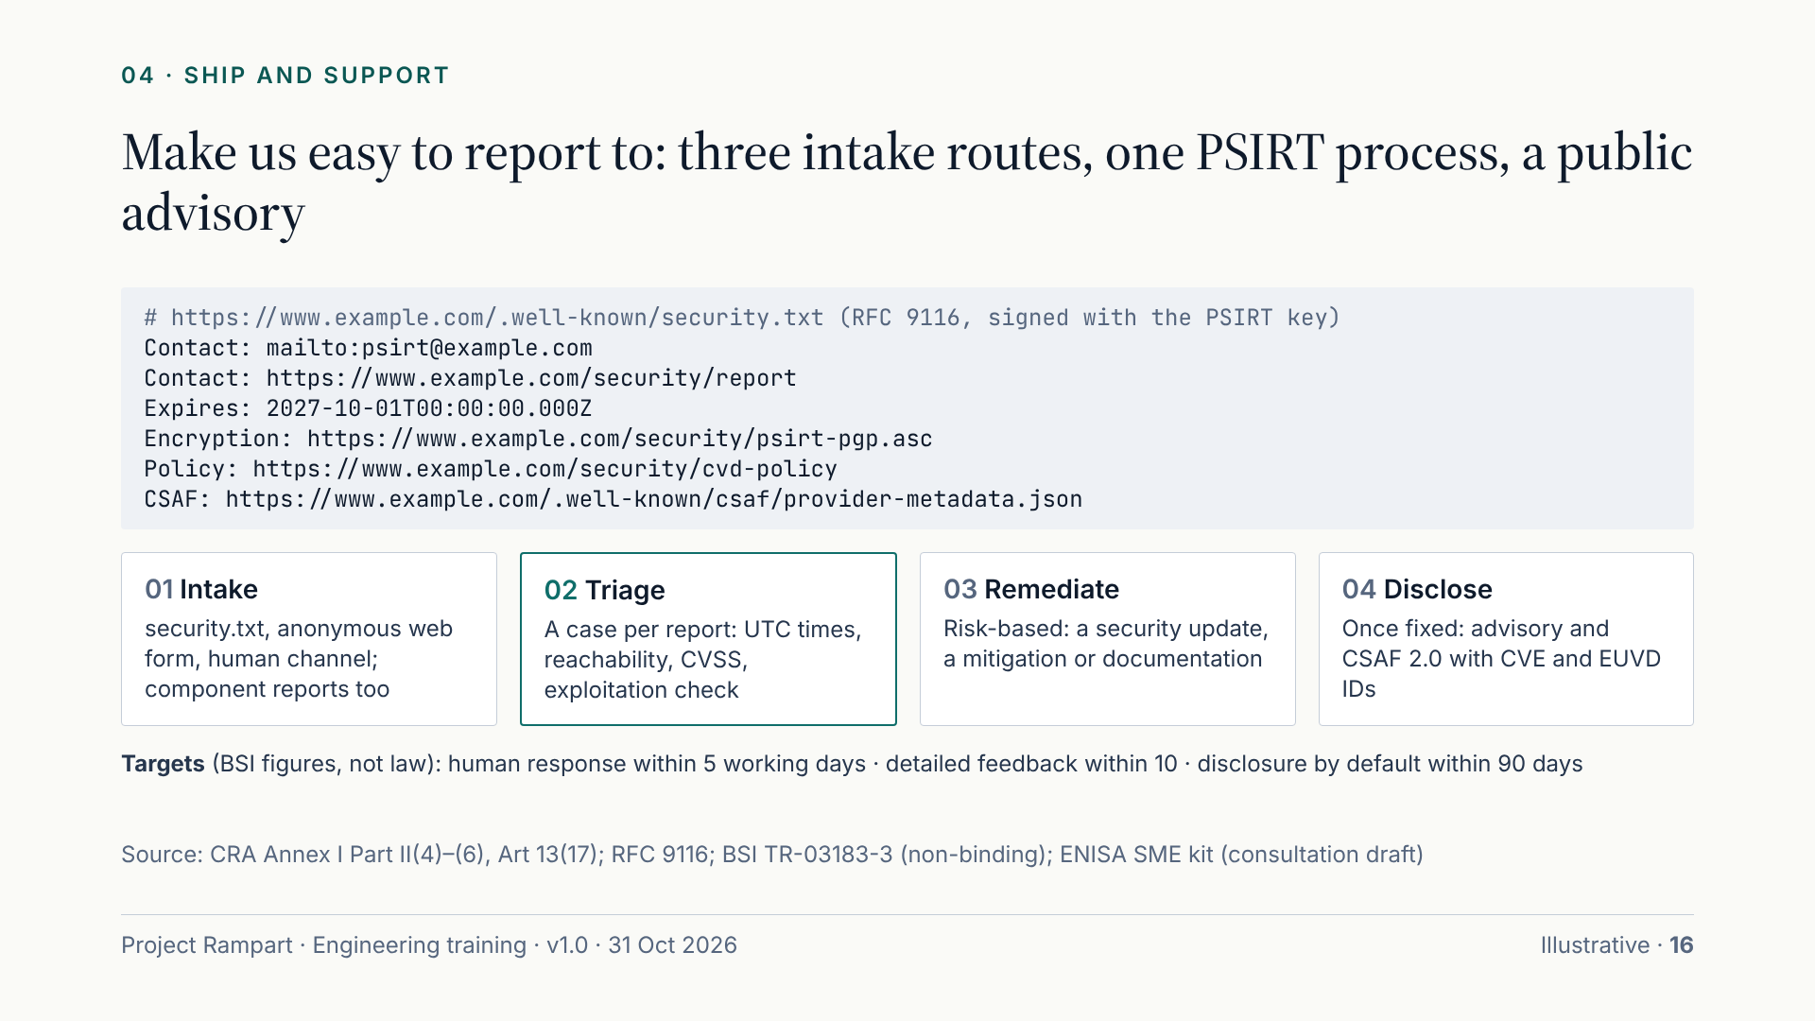
Notes:
Make us easy to report to. Every product needs three intake routes: a security.txt file at the well-known path, a web form that accepts anonymous reports, and a human channel, because the contact point must not be limited to automated tools. Accept reports about third-party components too. The lines on the slide are the core of security.txt: Contact and Expires are mandatory, Expires sits at most 12 months ahead, and an expired file is a common mistake, so check it quarterly. PSIRT opens a case for every report and monitoring hit, records times in UTC, checks reachability and exploitation, and sets severity. Our targets follow BSI: a human response within 5 working days, detailed feedback within 10, and disclosure by default within 90 days; these are BSI figures, not law. Once a fix exists, publish a human-readable advisory and a CSAF document carrying the CVE and EUVD identifiers.

Slide 17
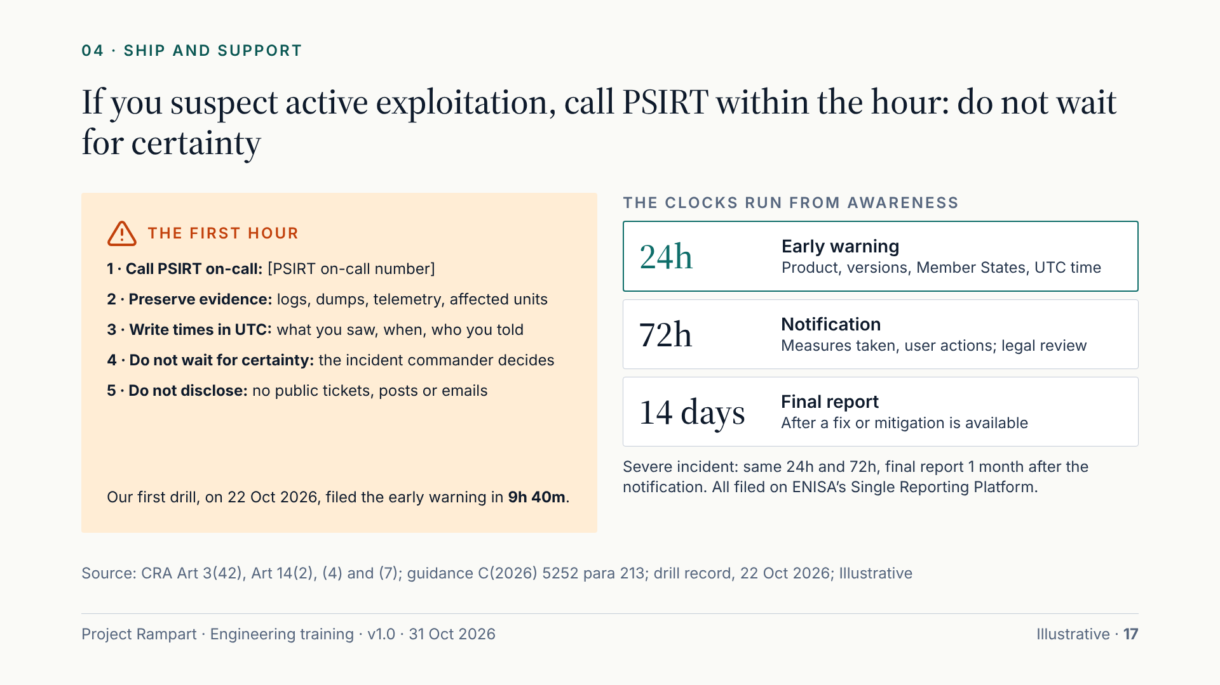
Notes:
Act on this slide. If you see signs that someone is exploiting one of our products, such as odd telemetry, a customer report or a researcher’s report, call PSIRT on-call within the hour. Do not wait for certainty: the incident commander decides when we are aware, after an immediate assessment. Preserve evidence: logs, dumps, samples and affected units. Note what you saw, in UTC. Do not disclose: no public tickets, posts or customer emails. Once we have a reasonable degree of certainty of exploitation, the clocks run: an early warning within 24 hours and a notification within 72 hours, then a final report 14 days after a fix is available, or one month after the notification for a severe incident. Remediation never pauses the clock. Researcher findings without exploitation evidence are not reportable on their own, but still go to PSIRT. Our first drill filed in 9h 40m.

Slide 18
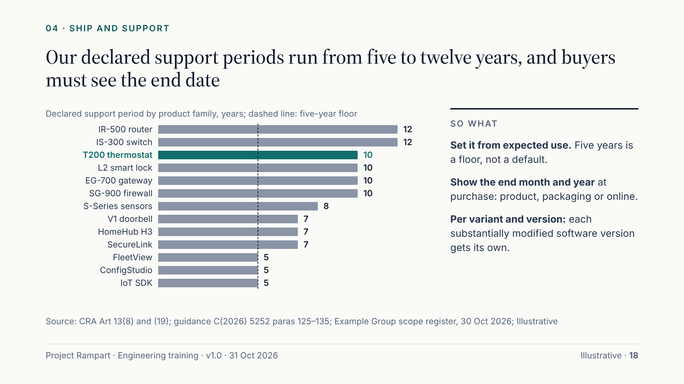
Notes:
The support period is a product decision with legal weight. It is the time during which we must handle vulnerabilities and provide security updates. It must reflect how long customers can reasonably expect to use the product, and be at least five years unless the product is expected to be in use for less. The guidance is explicit that five years is a safeguard, not a default: routers and industrial equipment are typically used for much longer. Our declared periods run from five years to twelve for the industrial router and switch; the T200 is ten. The end month and year must be shown at the time of purchase, with an end-of-support notice where feasible. Each substantially modified software version carries its own period, and a modification does not reset or extend it. Keep a version-support register, and remember that Article 14 reporting continues even after support ends.

Slide 19
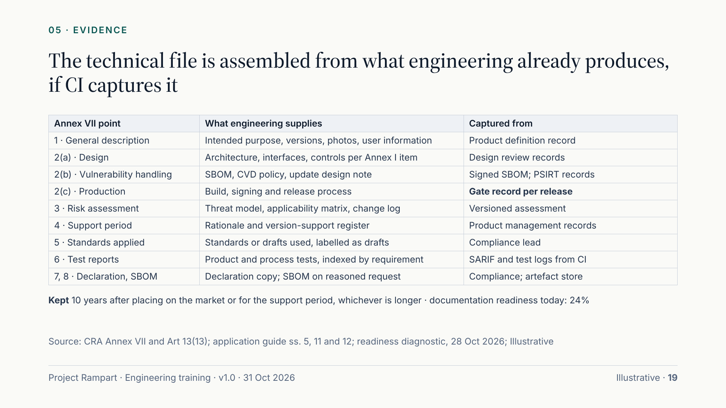
Notes:
The technical file is not written at the end; it is assembled from what engineering already produces. Annex VII sets the contents. Point 1 describes the product. Point 2 covers design, vulnerability handling, including the SBOM and the update design, and production, including your gate records. Point 3 is the risk assessment, point 4 the support-period rationale, point 5 the standards or specifications applied, which today means drafts labelled as such, and point 6 the test reports. A copy of the declaration and the SBOM complete it. For this to work, CI must emit the evidence: SARIF scan results, signed SBOM attestations, signed artefacts and the gate record committed with the release tag. Everything is kept for ten years after placing on the market or for the support period, whichever is longer. Documentation and declaration is our second-least-ready domain at 24%, so this is where pipeline automation pays most.

Slide 20
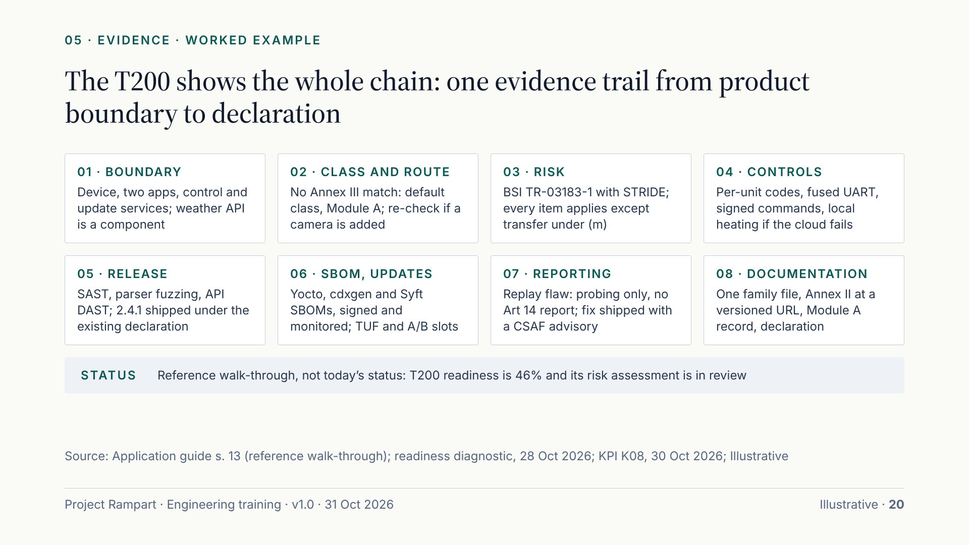
Notes:
Here is the T200 reference walk-through on one page. Boundary: the device, two apps and two cloud modules, with the weather API treated as a component. Class: heating control matches no Annex III category, so default class and Module A, re-checked if a camera or door sensor is ever added. Risk: BSI structure with STRIDE; every item applies except the transfer half of (m). Controls: per-unit codes, a fused UART, signed commands and local heating when the cloud fails. Release: SAST, parser fuzzing, API testing and a gate record per release. SBOMs and updates: signed, monitored SBOMs, TUF metadata and A/B slots. Reporting: telemetry on the replay flaw showed probing but no successful exploitation, so the incident commander recorded no awareness and no report was filed; the fix then shipped with a CSAF advisory. Documentation: one family file. This is the target state, not today’s status.

Slide 21
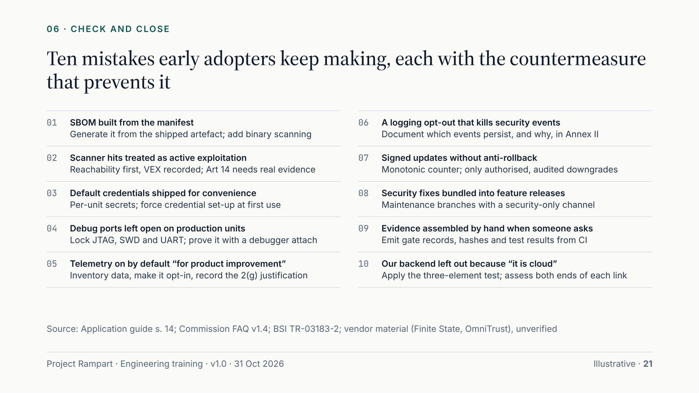
Notes:
Ten mistakes early adopters keep making, each with its countermeasure. Read the bold line as “don’t” and the line beneath as “do”. Scanner hits are not active exploitation: apply reachability, record VEX, and keep Article 14 for reliable evidence that someone has exploited the flaw. Signed updates without anti-rollback let an attacker reinstall an old, vulnerable version. Evidence assembled by hand when an authority asks is the failure that hurts most; early adopters report that security is often fine but the decision trail cannot be shown. And our own backend is in scope even though it runs in the cloud. Three more from the implementation guide are not on the slide: vulnerability data inside the SBOM, no per-version support declaration for software, and a third-party service such as the weather API mistakenly assessed as our own backend. Ask each team to pick the two that apply most to them.

Slide 22
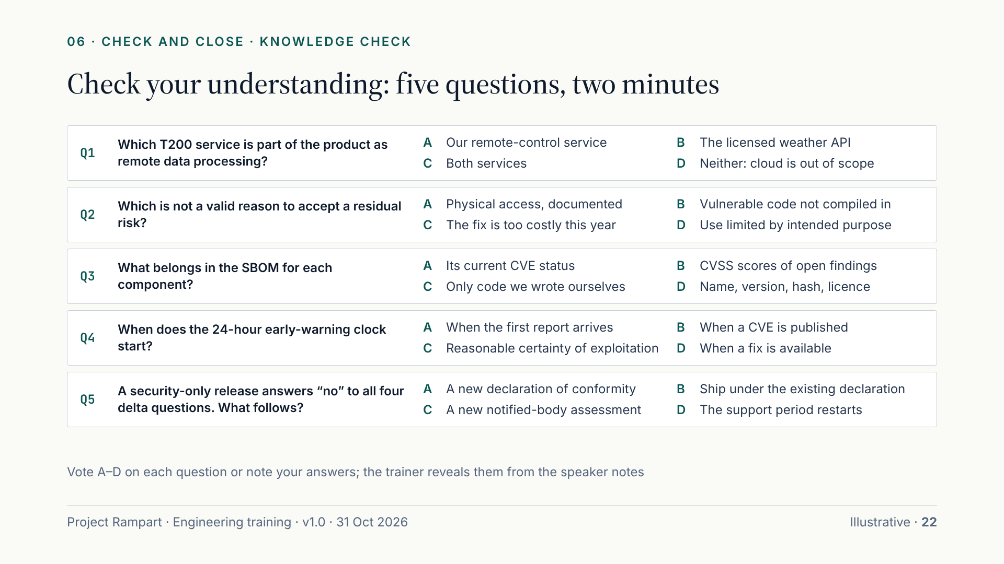
Notes:
Give the room two minutes; recorded viewers pause here. Reveal answers one at a time. Q1 is A: our remote-control service is remote data processing because we built it and the product needs it; the licensed weather API is a component under due diligence. Q2 is C: cost is never a valid reason to accept residual risk, whereas documented physical access, unreachable code backed by a VEX statement, and limits set by intended use can all be valid. Q3 is D: name, version, hash and licence belong in the SBOM; vulnerability status and CVSS scores go in VEX and CSAF instead. Q4 is C: the clock starts at awareness, meaning a reasonable degree of certainty of exploitation after an immediate assessment; suspicion only starts triage. Q5 is B: it is not a substantial modification, so record the four answers on the gate record and ship under the existing declaration.

Slide 23
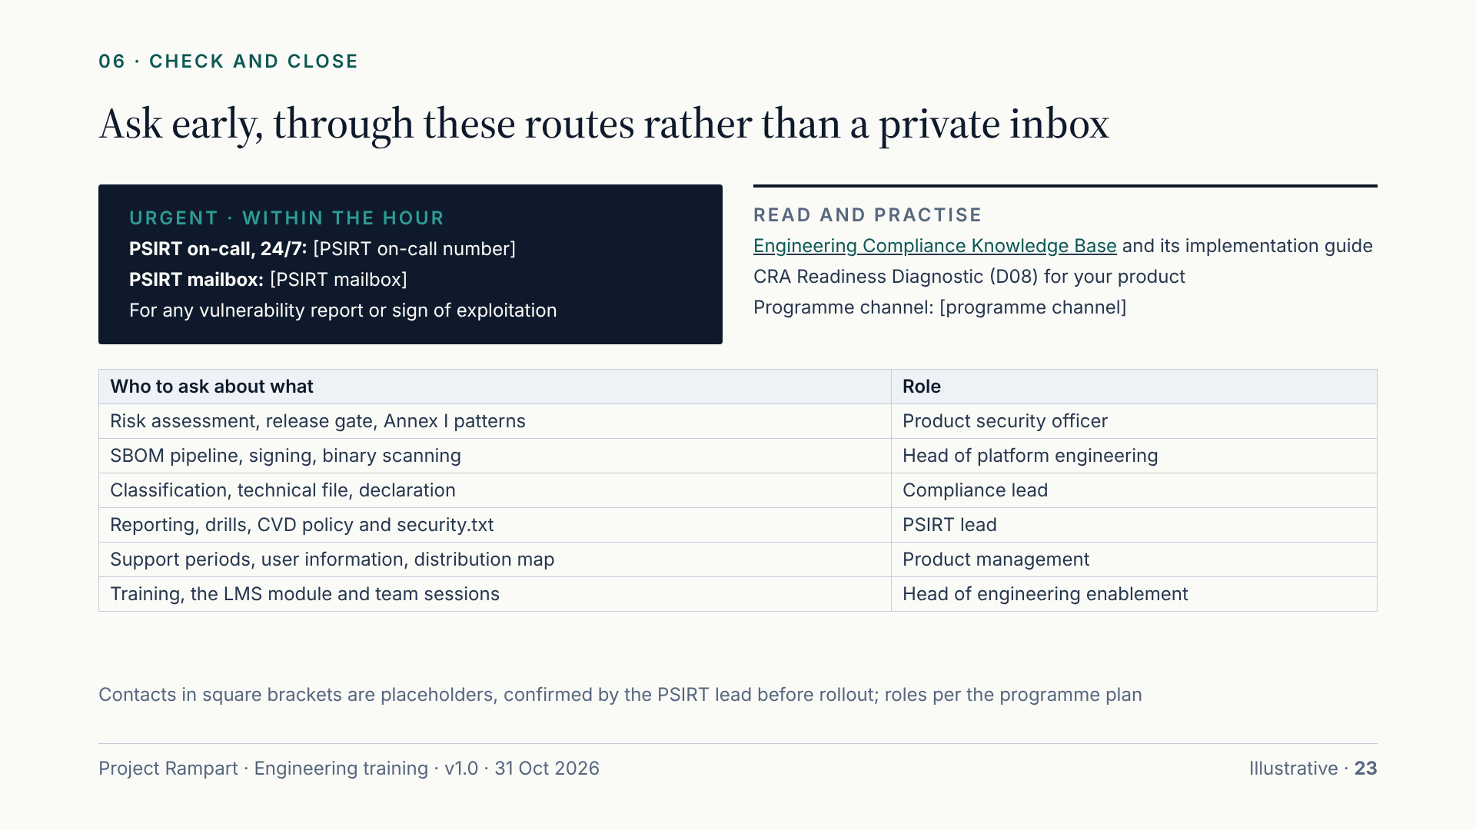
Notes:
Where to get help. For anything that might be a vulnerability or active exploitation, call PSIRT on-call or use the PSIRT mailbox, and never sit on it. The contact details are placeholders in this version; the PSIRT lead confirms them before rollout. For everything else, use the Project Rampart channel. The table names the owner role for each topic: the product security officer for risk assessments, the release gate and Annex I patterns; the head of platform engineering for the SBOM pipeline and signing; the compliance lead for classification, the technical file and declarations; the PSIRT lead for reporting and drills; product management for support periods and user information. The knowledge base and its application implementation guide hold the detail behind every slide. Product teams can assess themselves with the CRA Readiness Diagnostic. The next Article 14 drill, a weekend severe-incident scenario, is planned for 16 Apr 2027.

Slide 24
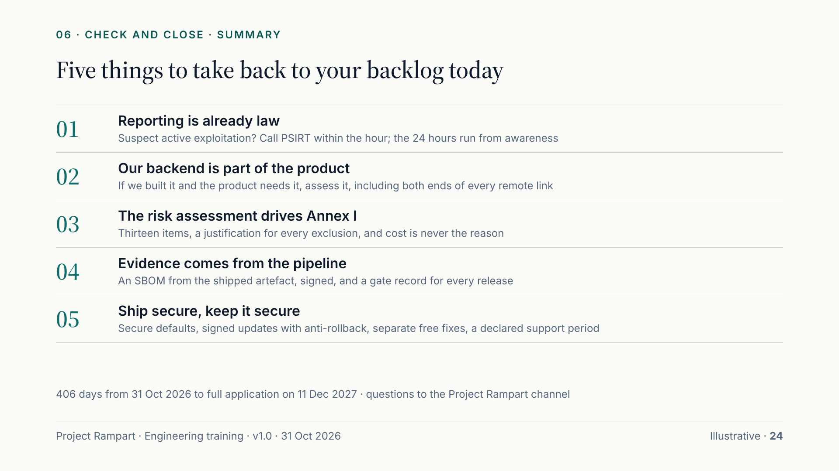
Notes:
Five things to remember. One: reporting is already law. If you suspect active exploitation, call PSIRT within the hour; the 24-hour clock runs from awareness. Two: our backend is part of the product when we built it and the product needs it, so assess both ends of every remote link. Three: the risk assessment drives the thirteen Annex I items; every exclusion needs a justification, and cost never justifies leaving a risk unaddressed. Four: evidence comes from the pipeline: an SBOM generated from the shipped artefact and signed, and a gate record for every release. Five: ship secure and keep it secure, with secure defaults, signed updates with anti-rollback, separate free security fixes and a declared support period. We have 406 days to 11 Dec 2027. Close by asking each team to name one change for their next sprint and post it in the programme channel.

